Slide 1
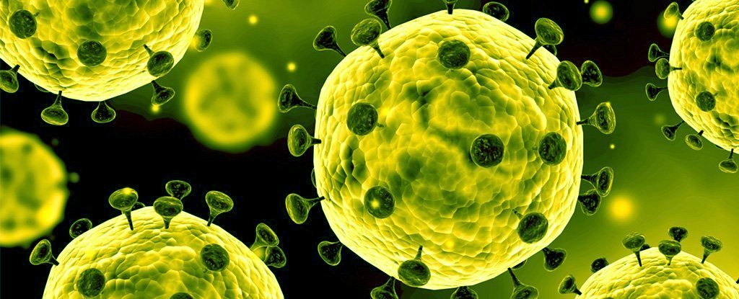
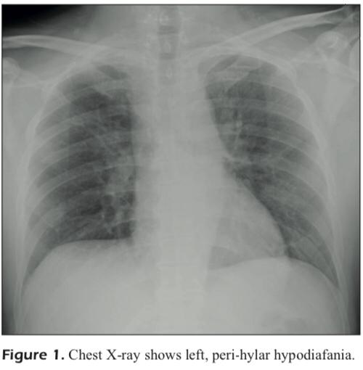
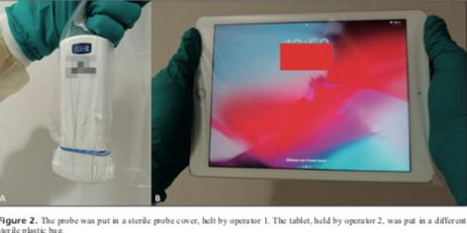
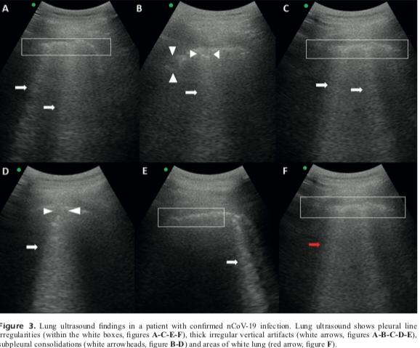
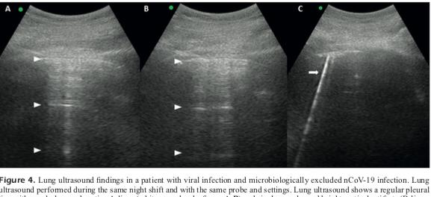
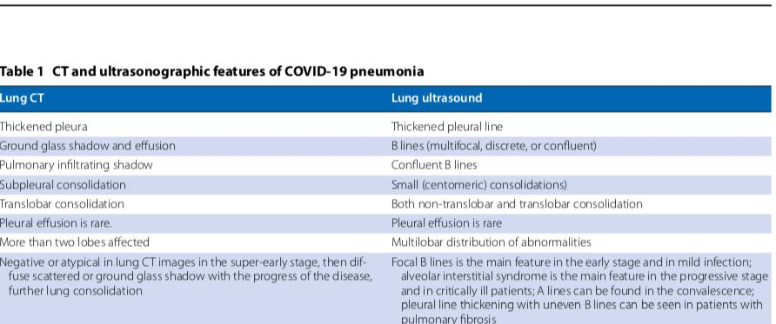
Point-of-Care Lung Ultrasound findings in novel coronavirus disease-19 pnemoniae: a case report and potential applications during COVID-19 outbreak
D. BUONSENSO1,2, A. PIANO3, F. RAFFAELLI2,4, N. BONADIA3, K. DE GAETANO DONATI4 , F. FRANCESCHI3
Abstract
Introduction
Lung US Technique
On 2019 December in Wuhan, China, a novel corona-virus disease-19 (nCOV-19) infection began. In different countries, the disease has infected several health workers. A documented case of a young man is reported with nCOV-19 infection evaluated with ultrasound and potential lung ultrasound applications in this setting. The Ncov-19 infection identification was allowed by lung ultrasound at bed-side. There are several other advantages associated with lung ultrasound which include repeatability during follow-up, costs are low, application is easier in terms of low-resource settings, and health workers exposition to patients that are infected is reduced.
Since the outbreak of the novel corona virus disease-19, the disease has spread in 68 different world countries. With inclusion of cruise ship that had 705 cases that were documented and classified as “others”. The symptoms of the disease which are common are cough and fever. These two symptoms have 4 days as the medium period of incubation. The suspicion of the disease was allowed by cluster observation which is pneumonia development and is seen as ground-glass opacity as main finding on chest computed tomography (CT). Despite huge publications, there are no reports yet on the lung ultrasound possible for evaluating patients with the disease. A case of a young man is reported with Ncov-19 documented infection is evaluated with ultrasound with discussions on potential application in the context of the outbreak of kung ultrasound.
Convex probe (3.5 mHz) and a tablet that was wireless-connected were used to perform lung US. The devices were selected with an aim of minimizing device contamination risk and subsequent nosocomial spread despite providing images of lower quality. There were two operators (an ED physician and an ED nurse) who entered the isolation room and respected all WHO respiratory preventive measures, droplet, and contact isolation. The tablet and US probe were put in two sterile that were different, tablet covers and plastic probe. The ED physician performed lung US via wireless probe while ED nurse was responsible for freezing and storing images/videos. Only ED physician entered into contact with the patient as the procedure was agreed so as to reduce risk of contamination. There was sterilization of tablet and probe after the project. There was scanning of the thorax for the 12 areas of lung. A normal pleural line with A-lines reverberating regularly and one, regular vertical artifact (B-line) noted in a single areas wee shown by lung US.
Name
Institution
Date
Chest X-ray
Tablet and Probe in sterile
Lung US findings
Lung US findings for nCOV-19 patient
The Lung US showed that on the anterior and posterior emi-thorax bilaterally, pleural line which is an irregular with subpleural consolidations that are small, white areas of lung and thick, confluents and irregular vertical artifacts (B-lines). The spared areas were bilaterally present and mixed with pathological areas. Images made with the same device and using same settings of US and performed during the same shift of ED on a 38-year old woman as a control-case. The woman had high-grade fever, diffuse muscle and joint pain as well as cough. The woman came from a coronavirus area of high-burden in Northern Italy and tested negative to nCOV-19 eventually. Normal pleural line with A-lines regularly reverberating and only one, regular vertical artifact (B-line) noted in a single area by lung US.
Lung US findings of a patient with viral infections
Lung US limitations
CT and US findings
Factors affecting the findings
The lung US findings depends on the disease stage, lung injury severity, and comorbidities.
A recognized lung US limitation is that it cannot detect those lesions that are extremely deep in the lung. such as the abnormality . This is because the US is blocked by aerated lungs.
Use US instead of CT?
Future recommendations
.US can be used instead of CT due to low costs and point of care use, safety, repeatability, and radiation absence.
The role of lung US should be evaluated by clinicians and safe procedures be followed in order to minimize the contamination risk. This will ensure the findings will be translated to the new emerging respiratory infection outbreaks’ treatment. The high-risk human-to human transmissions will be dealt with accordingly by lung US saving the world from a major pandemic.

